Slide 1
USCG Maritime Law Enforcement Academy 2021 Hurricane Training

Slide 2
2021 Forecast
* ACE: Accumulated Cyclone Energy

Slide 3
Hurricane Conditions
Hurricane Condition IV: Seasonal alert from 01 June to 30 November.
Hurricane Condition III:
Threatening winds possible within 48 Hours.
Hurricane Condition II:
Threatening winds possible within 24 Hours.
Hurricane Condition I:
Threatening winds possible within 12 Hours.

Slide 4
Hurricane Condition IV
Awareness and Preparation Phase.
Seasonal alert from 01 June to 30 November.
All GVs will be kept at 7/8 fuel.
Important Links and Apps
www.ready.gov/hurricanes
SC Emergency Manager App
FEMA App
Hurricane: American Red Cross App
Notes:
Visit the National Weather Services' hurricane preparedness week web page for amplifying information.

Slide 5
Develop an Evacuation Plan
Notes:
Visit the National Weather Services' hurricane preparedness week web page for amplifying information.

Slide 6
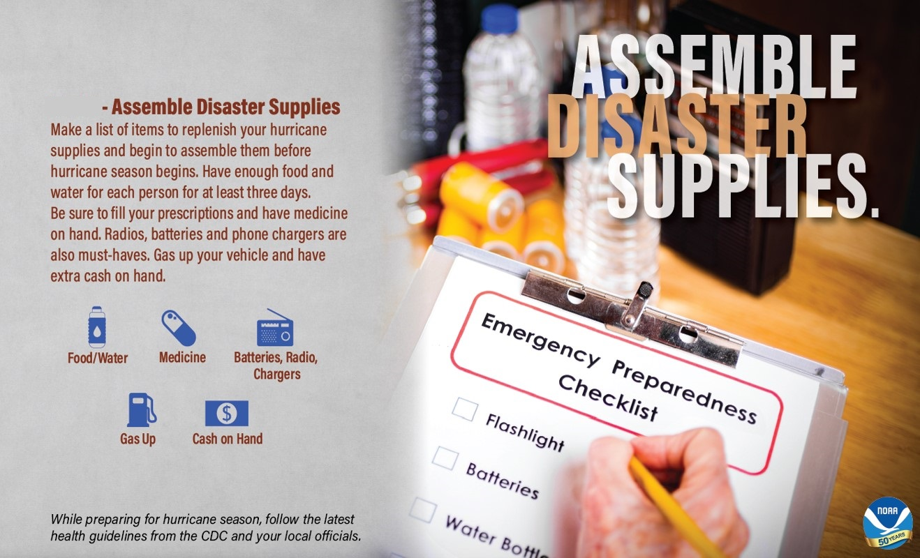
Assemble Disaster Supplies
Notes:
Visit the National Weather Services' hurricane preparedness week web page for amplifying information.

Slide 7
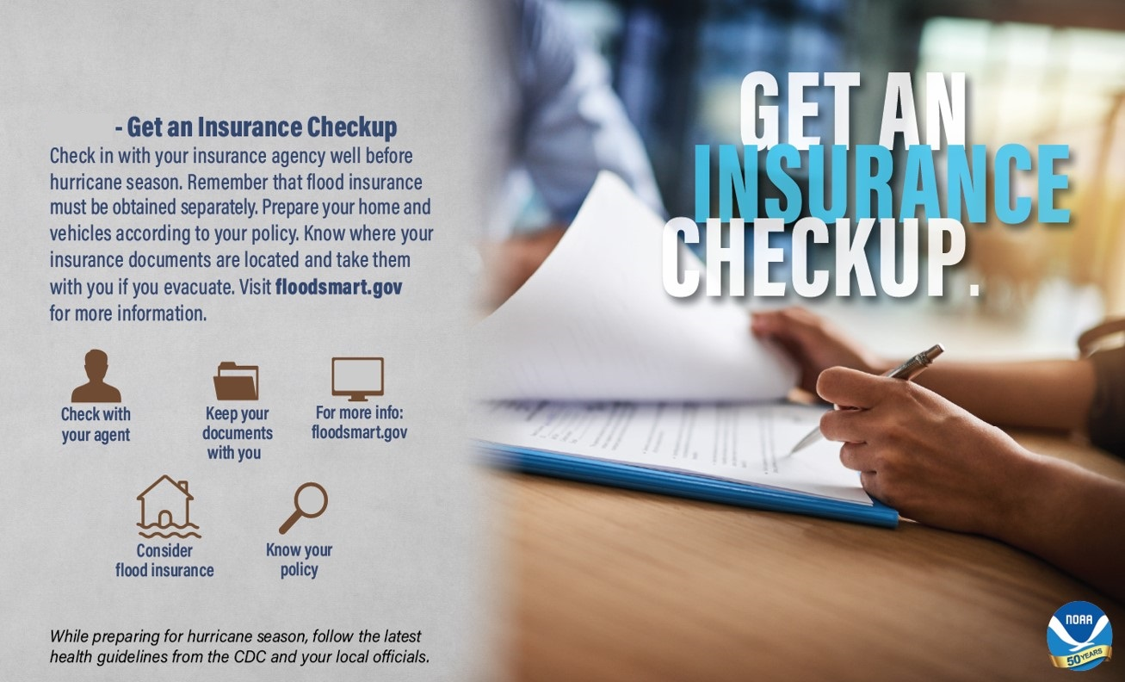
Secure an Insurance Check-Up
Notes:
Visit the National Weather Services' hurricane preparedness week web page for amplifying information.

Slide 8
UPDATE YOUR INFO !
Visit the CGPAAS Web page:
https://cgpaas.uscg.mil
DEERS, log into milConnect: https://milconnect.dmdc.osd.mil/milconnect
Verify your information with ADMIN for AWS notifications.
Update all personal information in Direct Access.
Notes:
Visit the National Weather Services' hurricane preparedness week web page for amplifying information.

Slide 9
CGPAAS versus AWS
CGPAAS and AWS are NOT the same system!
CGPAAS tracks you and your dependants accountability during an event.
AWS is a system used to pass pertinent information during an event.
Both CGPAAS and AWS are mandatory for CG members and GS civilian employees.
Notes:
Visit the National Weather Services' hurricane preparedness week web page for amplifying information.

Slide 10
Hurricane Condition III
MLEA will coordinate with FLETC concerning class cancellations.
ME A has ID’d chaperones for MLEA students.
NCVP will arrange to load the unit’s small boats, GVs, and golf carts onto the MARAD RO-RO’s.
Safety Coordinator will secure all loose gear.
CAT I Storm – Unit shall prepare students to shelter in place in building 39.
CAT II or higher – Unit shall expect and prepare students to evacuate to Shaw AFB in Sumter, SC.

Slide 11
MEA Student Evacuation
ME “A” Students will store gear on 2nd deck of Bldg 654 in the PSB office/conference room/breakroom
Additional Government Vehicle able to accompany evacuation party with gear/water/MRE’s
Shaw AFB provides initial linens for stay.
Notes:
Bottled Water and MRE’s were originally planned for ride out events. If evacuating to Shaw AFB, students have full access to DFAC, lowering the need for MRE’s/Water.

Slide 12
Hurricane Condition II
CAT I Storm - Students will shelter in building 39.
CAT II or higher – Students will evacuate to Shaw AFB in Sumter, SC per a MOA
Supply will have rental vans ready to transport.
Supply will ensure bottled water/MREs loaded.
OOD watch will shift to the chaperones.
Pertinent information will be passed using the AWS.

Slide 13
HURRICANE EVACUATION
The MLEA will follow the guidance set forth in the CGDSEVEN Hurricane Evacuation Message.
Limited Evacuation
Authorized/ordered movement of active duty members or civilian employees and dependents from their residences to the nearest available accommodations which may be government quarters. Used primarily for the temporary avoidance of severe weather. (hurricanes, floods, ice storms, fires, etc.)
Full Evacuation
Authorized/ordered movement or departure of dependents from one area to another. Primarily used where geographic areas expect or suffer extraordinary storm damage.

Slide 14
Entitlements
Entitlements begin when evacuation orders are issued and cease when evacuees depart safe haven location for safe return to his/her PDS, or when the District Commander issues a termination order, whichever comes first.
AD Coast Guard members will be issued TDY “evacuation” orders.
You and your dependents will be authorized per diem and mileage entitlements for the chosen Safe Haven.
Our designated safe haven is Atlanta, GA, or outside of the projected path of the storm.
If you evacuate to another location outside the entitlement boundaries of Atlanta, GA, (or a defined radius by D7), you will only receive travel reimbursement for up to the amount of our designated safe haven, regardless of where you may choose to evacuate.
If evacuating to a family member or friend’s home, you are authorized M&IE and mileage depending on the location.
Initial travel to the safe haven followed by travel to a non-authorized safe haven location is reimbursed at the initial safe haven rate.
The appropriate per diem percentages apply: Member – 100%, Dependents 12 and over 100%, Dependents 11 and under 50%.

Slide 15
Important Info!
If a hotel only offers smaller rooms that are not suitable for you and your family’s size, you can book more than one room or locate another hotel that offer suitable accommodations.
MBR must provide all lodging receipts, itemized with $0.00 balance for reimbursement.
CG members are authorized to use their GTCC to book lodging though Adtrav, but are not required to during evacuations due to the urgency of evacuation.

Slide 16
Information and Assistance
MLEA’s External Page – See here.
MLEAINST 3006.1F, Hurricane Response Plan
MLEA AWS Notifications
Incident Management Team (IMT) 1-800-582-5943; d07-smb-imtwatch@uscg.mil
Personnel Support Team (PST) 786-229-2931
D7 Hurricane Evacuation Messages
Notes:
IMT tracks storm and located at D7
PST Handles all accountability and entitlement issues
PST
Stands up when directed by D7 Commander and/or Base Miami Beach Commanding Officer
Deploys to Orlando, FL or other safe haven (e.g. Atlanta) deemed necessary
Check-in point for personnel and dependents who have evacuated (even if they do not evacuate to the safe haven)
Provides assistance with hotel reservations (if needed)
Issues orders to evacuees.
Provides travel advances if needed. Members must use govt travel cards if they have them.
Develops accountability rosters and reports to the IMT every 2 hours
Provides information to the PST regarding personnel in stricken areas
Comprised of administrative personnel and Housing Personnel

Slide 17
Post-Storm
1. FLETC will send a Re-Entry Team Damage Assessment Team to evaluate the facility.
2. 100% accountability will be made in CGPAAS.
DO NOT IGNORE THE CALL OR TEXT!
3. MLEA will pass pertinent information via AWS.
4. MLEA will return to work as soon as it is safe to return to work.

Slide 18
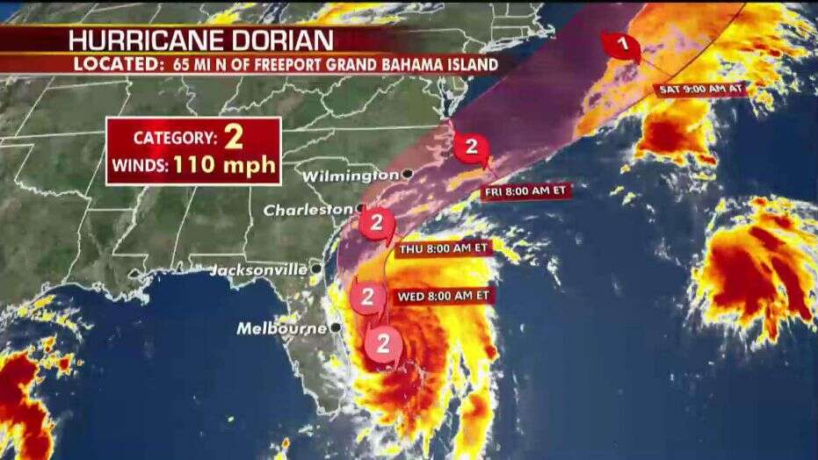
QUESTIONS?

